Slide 1
Decorator Pattern
Object oriented analysis and design
Spring 2017
Guide: Prof. Nguyen Thai.
By- Reshma r kapadnis

Slide 2
Agenda:
What is Decorator Pattern.
UML Diagram
Example
Advantages
Disadvantages
Basic concept of project
Demo

Slide 3
Decorative design Pattern :
Extending functionality without effecting the behavior of other objects.
Adding behavior dynamically .
This Pattern acts as wrapper of existing structure.
Decorator pattern adds simplicity to the existing function
Decorative pattern is an alternative to subclass.

Slide 4
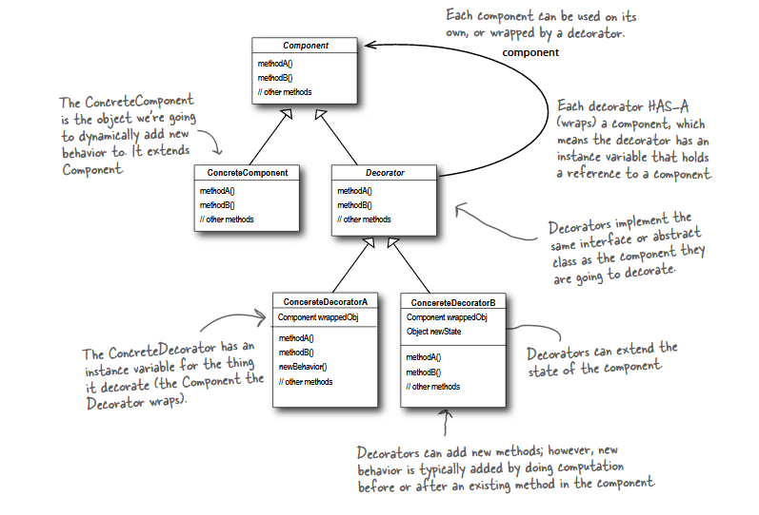
UML Diagram:

Slide 5
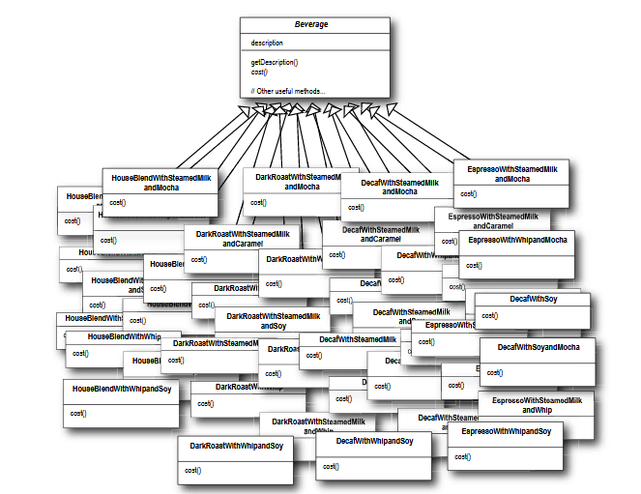
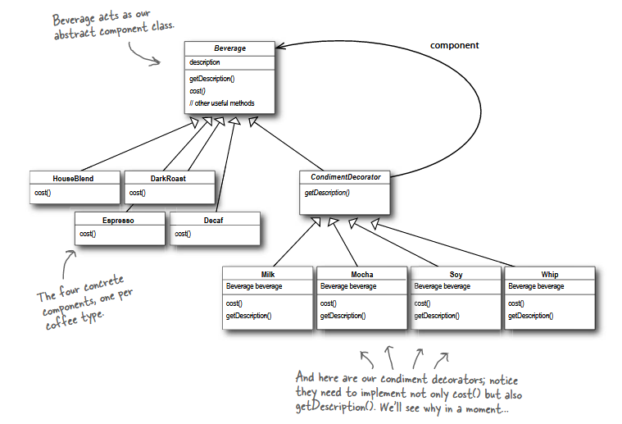
Example:

Slide 6
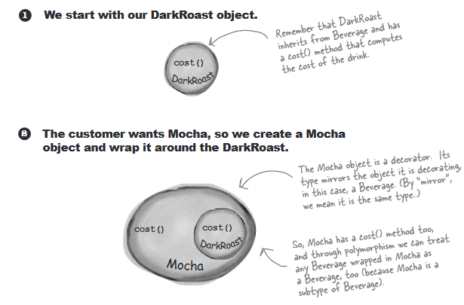
Constructing a Drink in order with decorator:

Slide 7
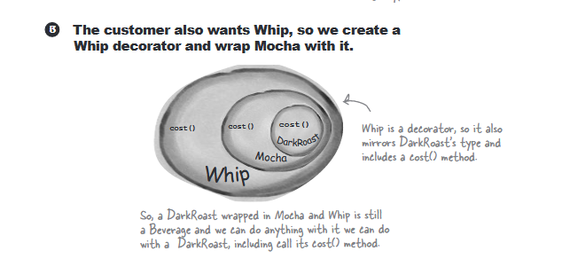

Slide 8
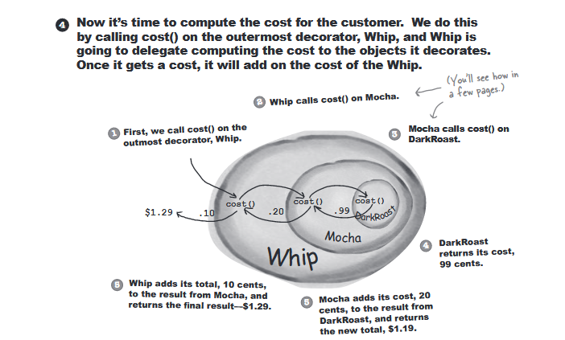

Slide 9
Advantages:
Decorators provide a flexible alternative to subclass for extending functionality.
Decorators allow behavior modification at runtime rather than going back into existing code and making changes.
Decorators are a nice solution to permutation issues because you can wrap a component with any number of decorators.
The decorator pattern supports the principle that classes should be open for extension but closed for modification.

Slide 10
Disadvantages:
Decorators can result in many small objects, and overuse can be complex.
It can be complicated to have decorators keep track of other decorators because to look back into multiple layers of the decorators chain starts to push the decorator pattern beyond its true intent.

Slide 11

Network Pinger:
Network pinger helps network/ IT administrators to determine if server is online.

Slide 12
Thank You

